Slide 1
Applied Statistical Analysis II Presentation on Replication
Claire Mooney

Slide 2
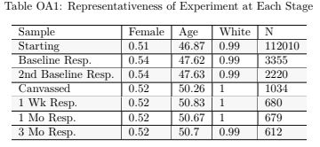
Details of Survey
“Personalising Moral Reframing in Interpersonal Conversation”
Population – Voters in Maine, US
Views on Abortion
5 different wave of survey
3,355 voters completed at least one baseline survey

Slide 3
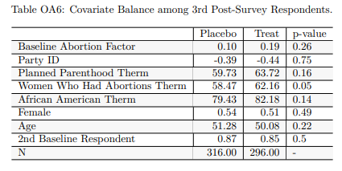
Reported Results of 3rd Post Survey Respondents

Slide 4
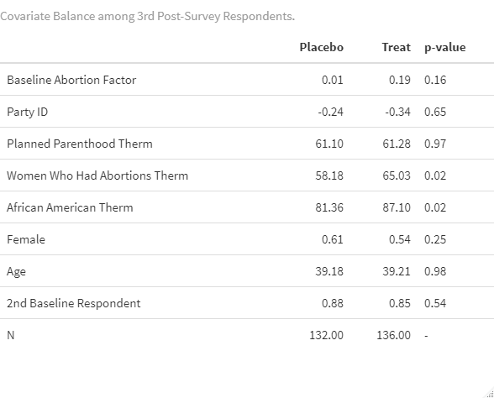
Replicated Results of 3rd Post Survey Respondents Under 50 Years

Slide 5
Direct Comparison With Under 50 Years Only

